Slide 1

Sales Forecasting and Optimization
by:
Amr Ashraf Amin Moussa
Mostafa Mohamed
Fares Mahmoud Eltanbouly
Radwa Amr
Lourina Emil
Moustafa Hesham
Date: 12/2025

Slide 2
Project Idea
(Problem Statement, Proposed Solution, UVP)
Problem Statement:
Unpredictable daily store sales caused by holidays, promotions, and seasonal patterns. Without a clear way to estimate future demand, businesses often rely on guesswork. This can lead to ordering too much stock, running out of products at the wrong time, or misjudging performance expectations.
Proposed Solution:
We built a time-series forecasting model that learns from past sales patterns and uses them to estimate future demand. After combining the sales, store, holiday, and oil data, we tested several approaches and selected the most reliable one. The final model generates clear forecasts that support planning and daily operations, which was Facebook Prophet model.
Unique Value Proposition:
Our project stands out because we built the entire dataset ourselves by merging multiple real store data sources, cleaned it thoroughly, and compared several forecasting models under the same conditions. The final system delivers reliable store-level forecasts that are practical and easy to use.
12/2025

Slide 3
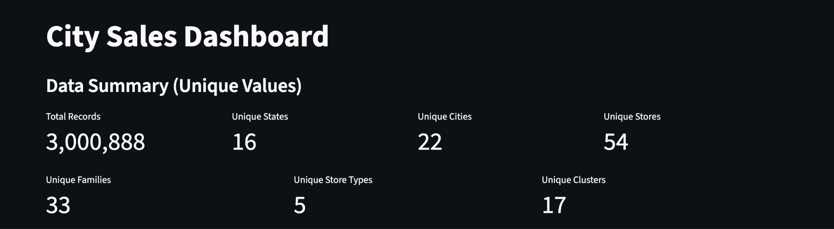
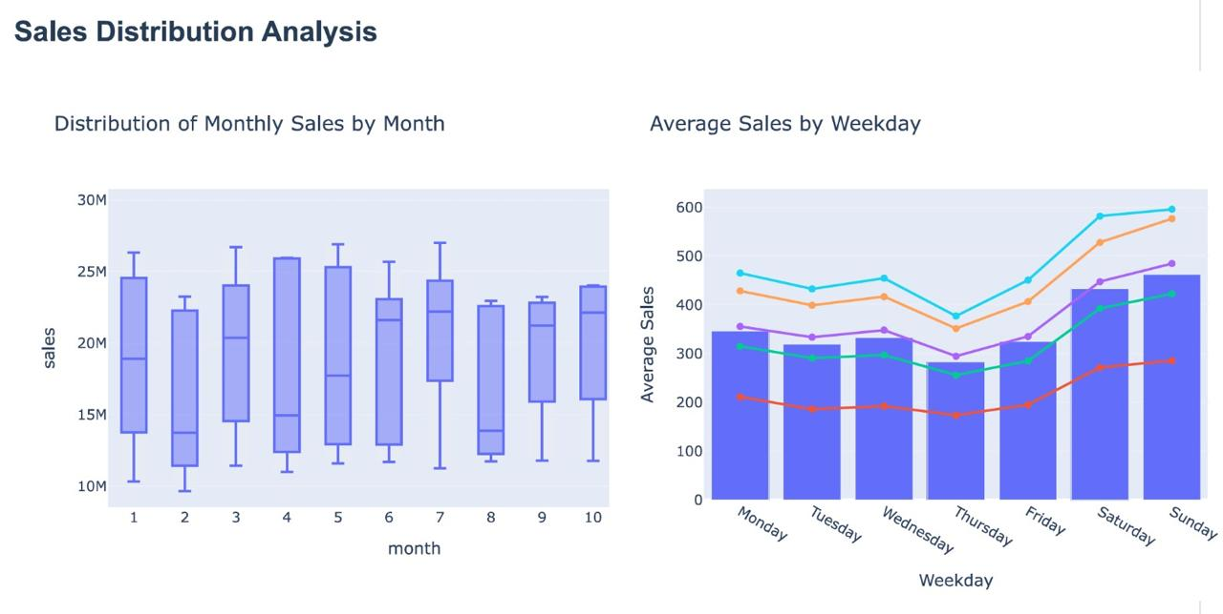
Project Wireframes:
Dashboard Overview:
Our interface centers around a simple sales dashboard that summarizes the key parts of the dataset. Users can view the total number of records, unique stores, cities, states, families, store types, and clusters. This gives a quick understanding of the overall scale of the data before exploring forecasts.
Also, In Dashboard Dash App have many insights about sales like Distribution of Monthly sales by Month and Average Sales by weekday.
12/2025

Slide 4
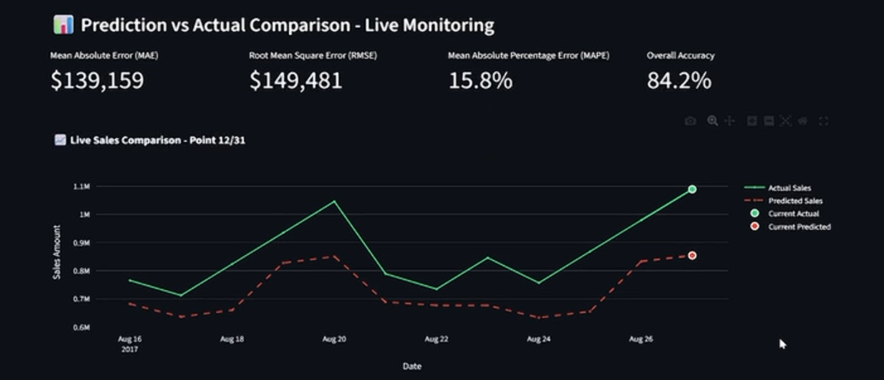
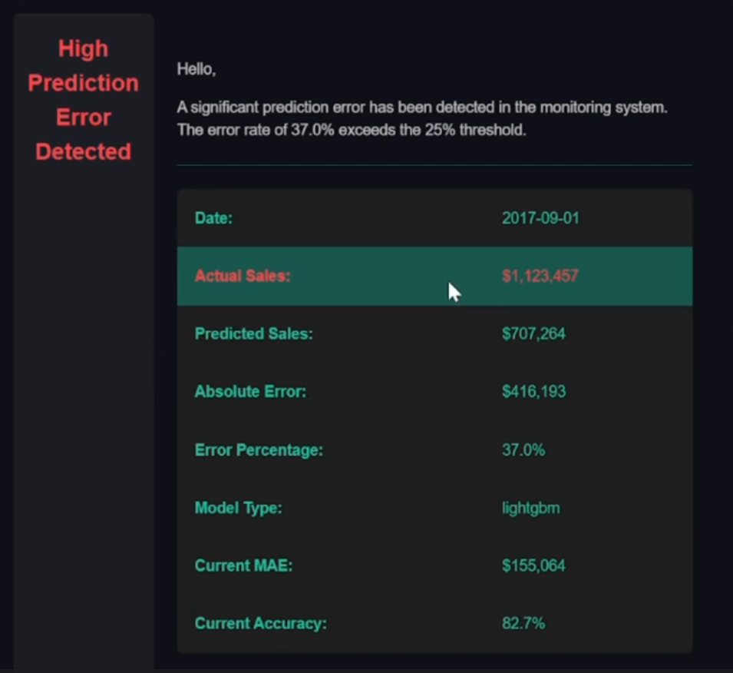
Project Wireframes:
User Journey:
From the Monitoring, the user can tracking Actual and predictions data Day by day and see if
Have a problem will send alert to email with details
including (Date- Actual sales – Prediction sales Error percentage – Model type – Current MAE Accuracy) About results
12/2025

Slide 5
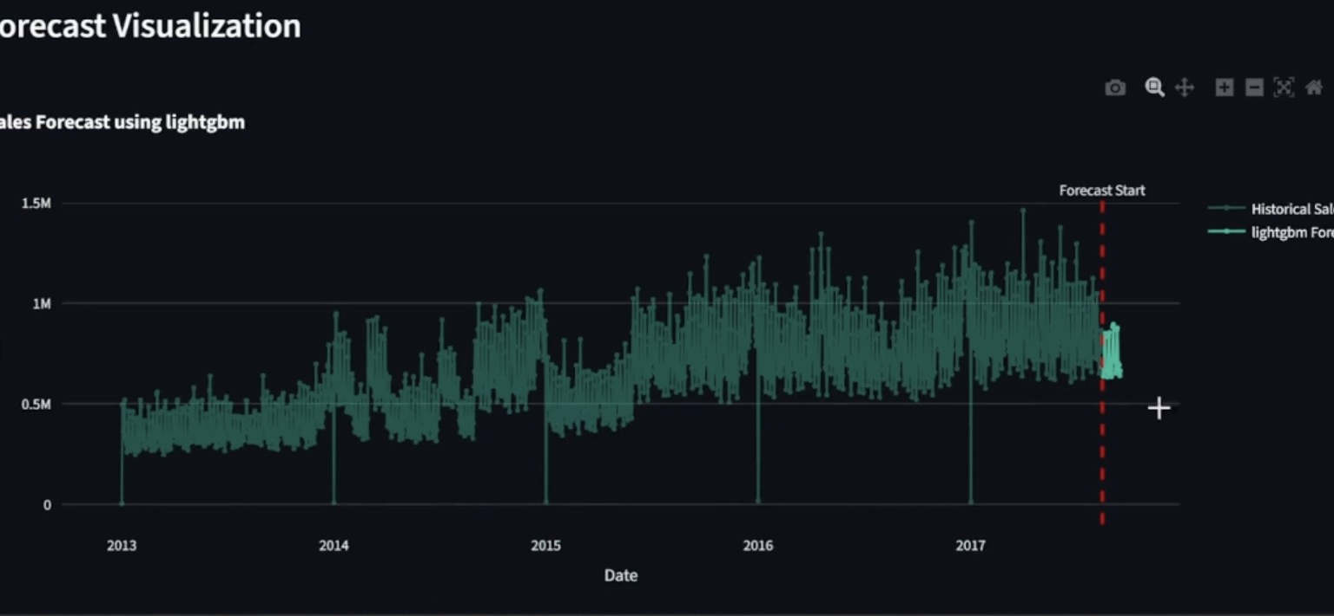
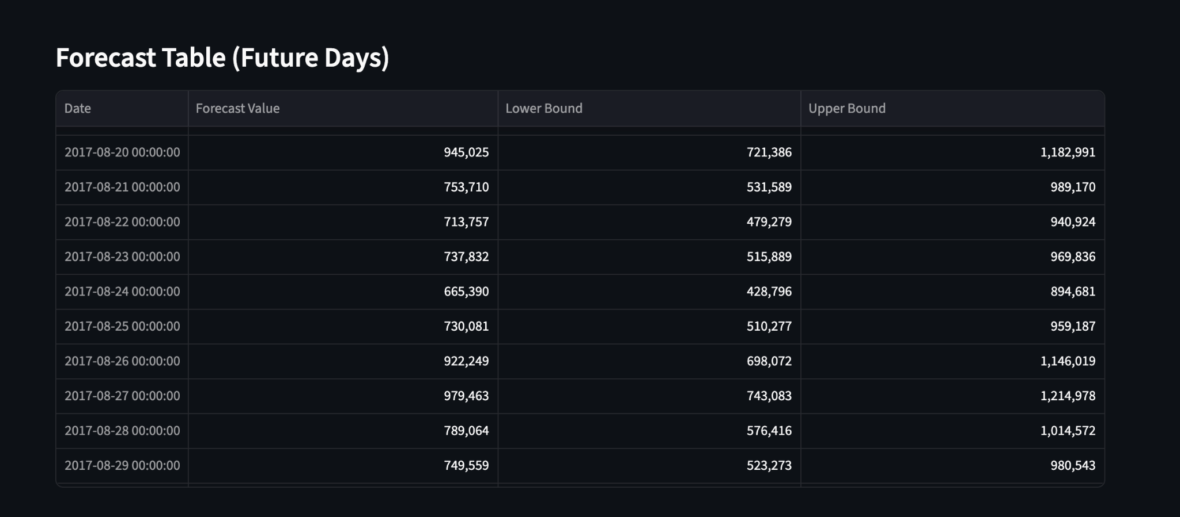
Project Wireframes:
User Experience:
Users begin with an interactive chart showing past sales and the model’s future predictions.
They can hover over the plot to inspect exact values and see how sales are expected to move.
A forecast table underneath provides daily predicted values with clear upper and lower bounds.
The layout lets users move easily from overall trends to specific numbers needed for planning.

Slide 6
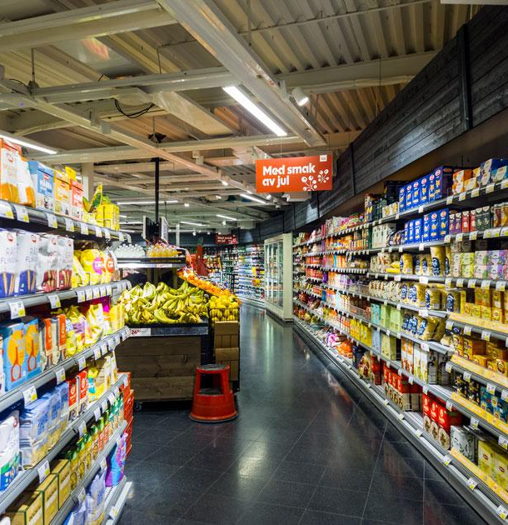
End Users & Core features
Primary End Users
Store Managers: need reliable estimates to organize inventory, staff scheduling, and daily operations.
Operations & Planning Teams: rely on future sales numbers for purchasing decisions and budgeting.
Regional or Head Office Supervisors: oversee multiple stores and compare performance across locations.
Key Features
Interactive Sales Forecast Chart Shows historical trends and future predictions, helping users quickly understand expected demand.
Daily Forecast Table Provides exact future sales values with upper and lower bounds, useful for stock ordering and staffing.
Time Range Selection Users can select the forecast horizon (e.g., next 7 or 30 days) based on planning needs.
Store and Region Insights (from the dataset) Since the dataset includes cities, states, store types, and clusters, users can filter or interpret forecasts at a store-level perspective.
Clean Dashboard Summary Shows total records, unique stores, cities, states, families, and clusters to help users understand the scale of the data.
How These Features Solve User Problems
Store Managers: They get clear and reliable forecasts, helping them avoid stockouts, reduce waste, and schedule staff better during peak periods.
Operations Teams: The daily forecast values and confidence ranges help them plan purchasing more accurately and reduce the cost of over-ordering.
Supervisors & Planners: The dashboard and forecast trends help them compare performance across stores and identify which regions may need more support or resources.
12/2025

Slide 7
Data Structure
Dataframe Architecture
Our data is organized in a relational structure built from several linked tables.
The core table contains daily supermarket sales, and it is connected to supporting tables with store information, holidays/events, oil prices, and transactions (used mainly during exploration).
Key entities
Sales (Fact Table)
Fields: date, store_nbr, family, sales, onpromotion
Granularity: one row per store–family–date
This is the main table used for forecasting.
Stores (Dimension Table)
Fields: store_nbr, city, state, store_type, cluster
Describes each store’s location and category.
Dataflow:
Data CSV Files: Multiple CSV files (train, stores, oil, test, holiday_events) were merged using left joins to create a unified dataset.
The resulting DataFrame dimensions were: Before cleaning: (3,054,348 rows, 12 columns) After cleaning: (3,000,888 rows, 12 columns)
DVC: the processed training data is saved in the dataset_model folder to ensure versioned, reproducible experiments. Trained models are stored in the models directory, providing organized and easy access for evaluation and deployment.
Holidays & Events
Fields: date, day_type (Holiday, Additional Day, Event, Work Day, etc.)
Adds context about special days that impact sales.
Oil Prices
Fields: date, dcoilwtico
External economic signal that can influence demand.
12/2025

Slide 8
Programming language & Frameworks
Programming Language
Python (primary language used across the entire project)
Development Environment
Jupyter Notebook for data cleaning, EDA, feature engineering, and model training
Streamlit for creating the interactive forecasting interface
Key Libraries & Tools
Pandas (data manipulation)
NumPy (numerical processing)
Matplotlib / Plotly /Seaborn (visualization)
MLflow
DVC
XGBoost / LightGBM / Prophet / Statsmodels (models)
Scikit-learn (preprocessing, metrics)
12/2025

Slide 9
Live Application + Testing
12/2025

Slide 10
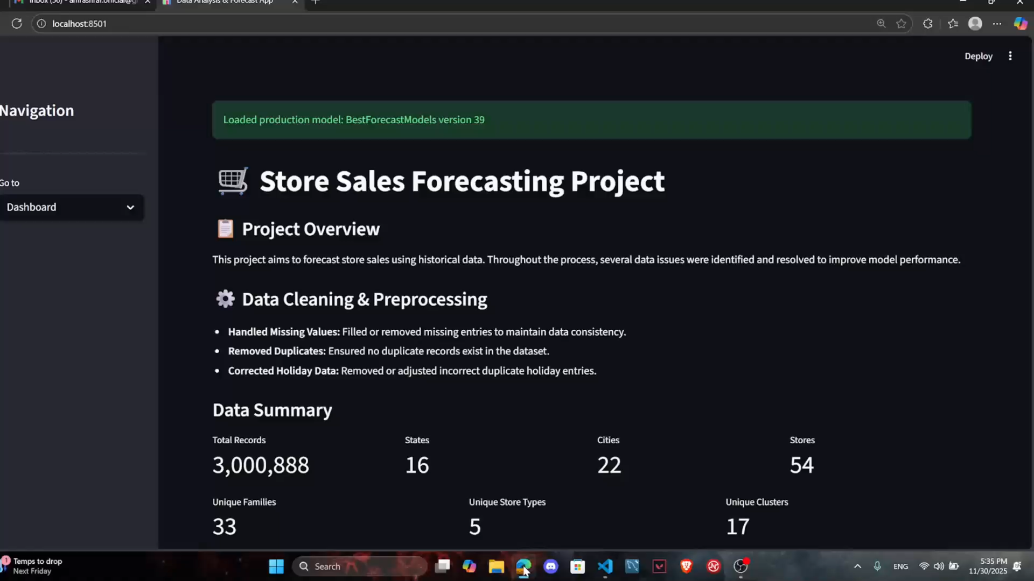

Slide 11
Deliverables
Reports & Documentation to be Provided :
[Data Exploration Report - Dataset Cleaning & Analysis
Forecasting Model Performance - MLOps Report - Monitoring Setup-Final Report -Final Presentation]
Timelines: 1- Collecting & Preprocessing (2 weeks)
2- EDA & Dashboard (1 week)
3- Building Models ( 2 weeks)
4- MLOps, Deployment, and Monitoring (2 weeks)
5- Final Documentation and Presentation ( 1 week)
GitHub Repo: https://github.com/Amr2272/Final-Project
12/2025

Slide 12
Project Team & Roles
Core Team Members : Data Scientist
Roles: 1- Amr Ashraf : Sarimax + Preprocessing +Live Demo
2- Mostafa Mohammed: Prophet +EDA +Monitoring + MLflow +Alert
3-Radwa Amr: Preprocessing + Arima + DVC
4-Fares Mahmoud: EDA +Reports +Final presentation
5- Lourina Emil: Plotly + XGBoost
6- Mostafa Hesham: LightGBM +Dashboad (homepage)
Collaboration Method : GitHub
12/2025

Slide 13
Thank You
Contact information:
Members :
1- Amr Ashraf Amin (Team Leader) 2- Mostafa Mohammed
3- Radwa Amr 4- Fares Mahmoud
5- Mostafa Hesham 6- Lourina emil
We Welcome any questions or suggestions to improve the project
12/2025

